Slide 1
Banner 9 Navigation Keys

Slide 2
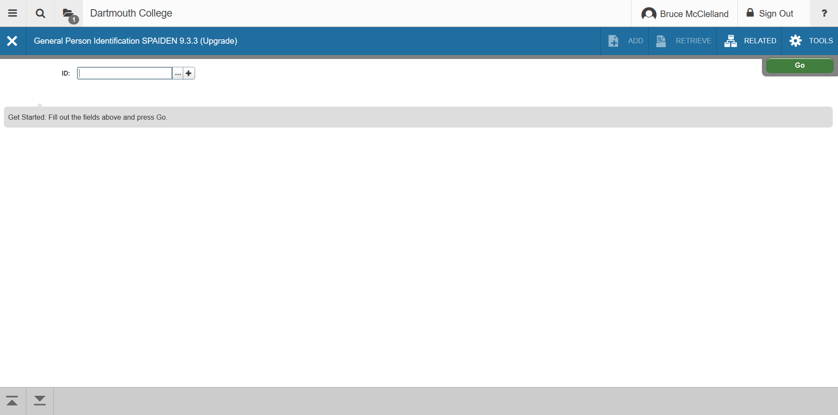
If you know the person’s ID, enter it in the ID field below and press Go.

Slide 3
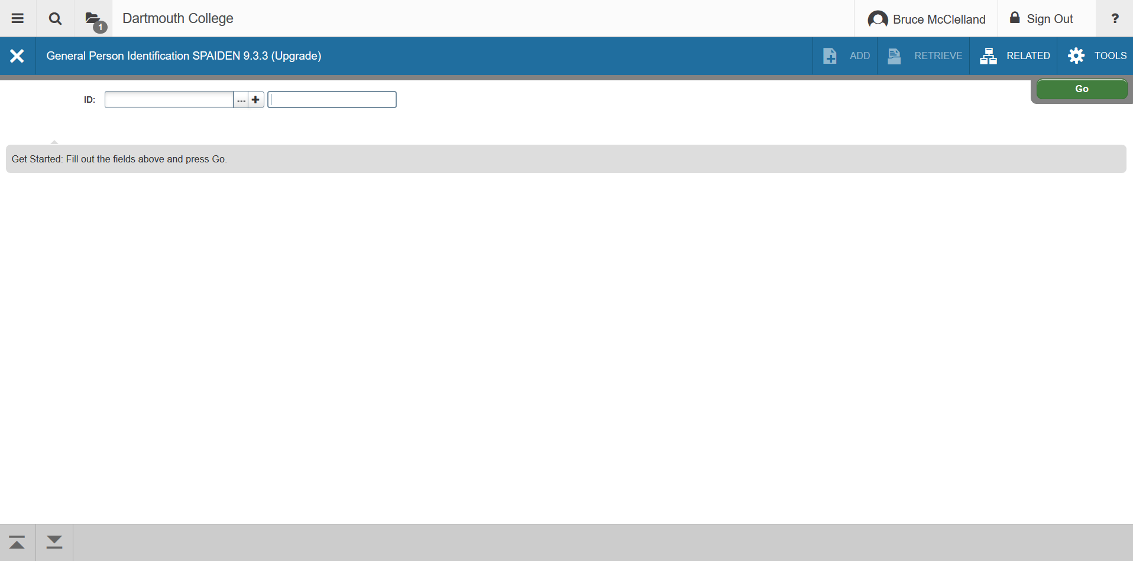
If person’s ID is not known, click on the Tab key from the ID field. This will take you to a new dialog box where you can enter the name.

Slide 4
If person’s full name is not known, click on the ellipsis. This will take you to a new dialog box where you can enter a partial name.

Slide 5
