Slide 1
Banner 9 Info Session

Slide 2
Ellucian will no longer develop new versions of Banner 8x as of January 2019
Browser compatibility issues with Java
Banner 8 is an outdated user interface that has needed upgrading for several years
This will be the biggest change in Banner since its installation in 1996

Slide 3
This upgrade will be done in a phased release to various populations across campus
Phase one will affect Dartmouth staff users (not students or faculty)
Every Banner user will ultimately be impacted by this change including faculty, students and staff

Slide 4
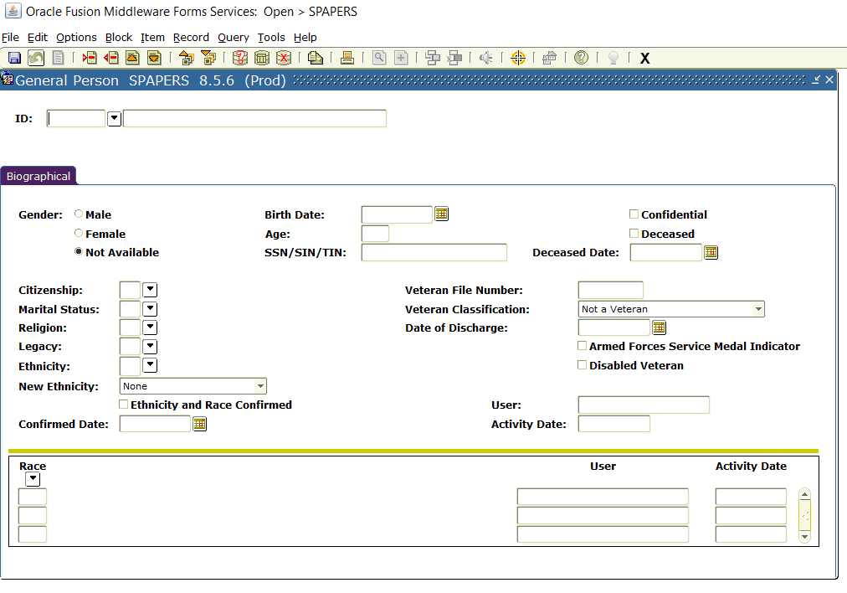

Slide 5
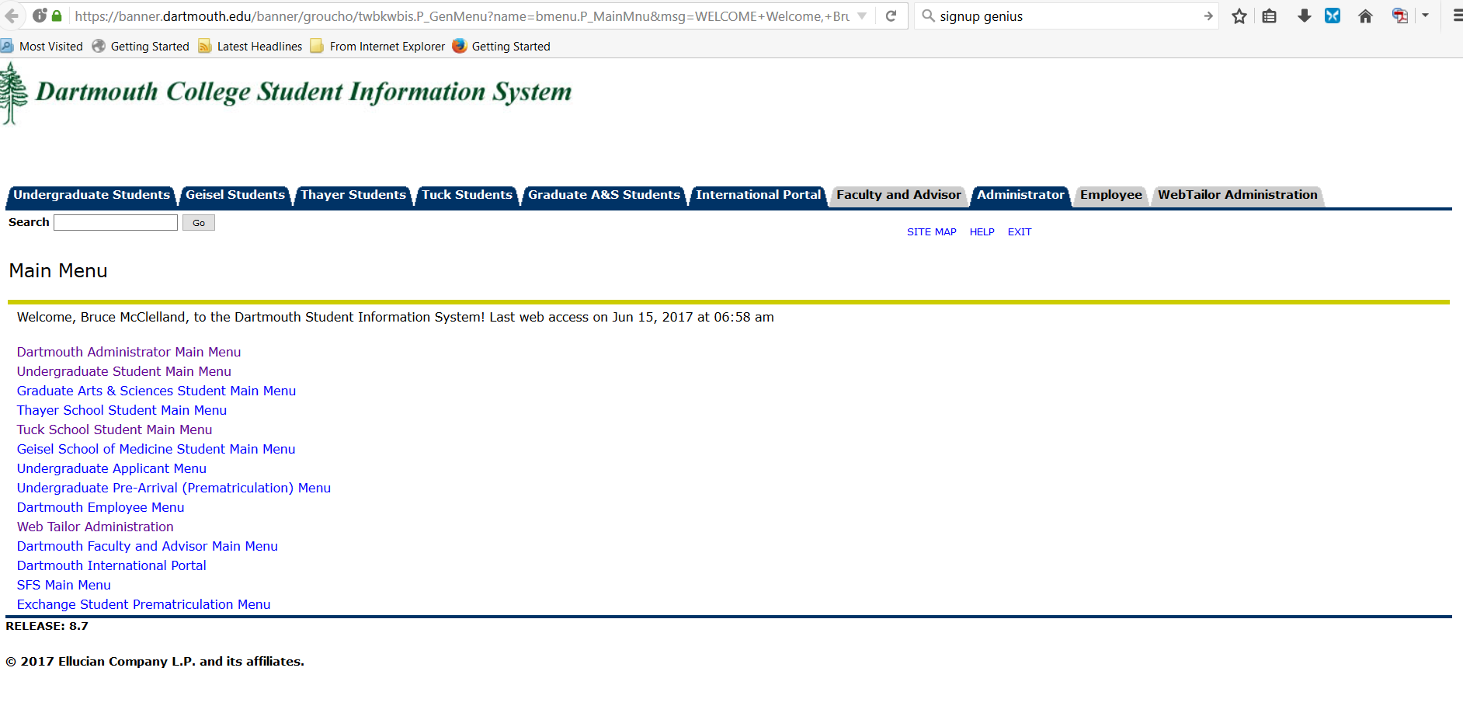

Slide 6
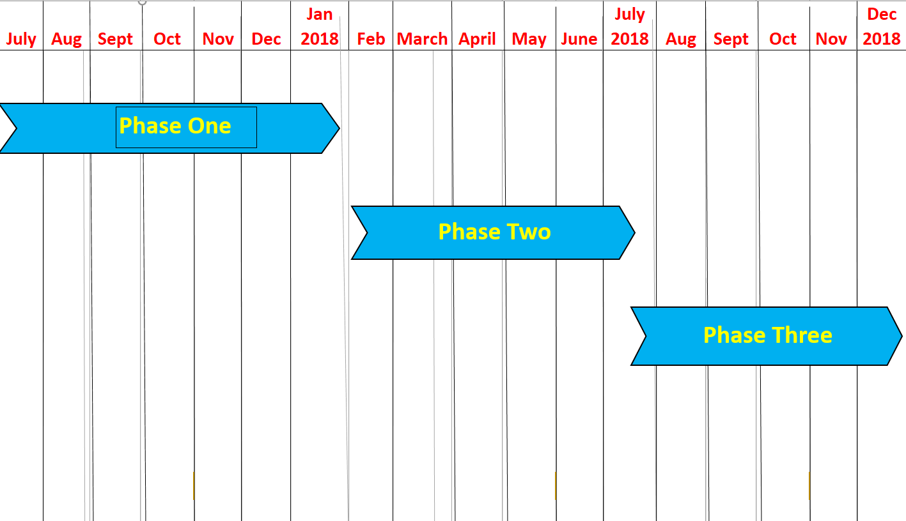

Slide 7
Phase One – May 2017 to January 2018
Will involve only the Banner administrative users
Approximately 230 users will be involved
Anyone who currently uses Banner Forms will be impacted by the change of look and feel
Go-live for Banner 9 pages is scheduled for January 26, 2018

Slide 8
Phase One – May 2017 to January 2018
Improved usability for administrative users
One login will get you into all your Banner information
Enhanced search capability
Reorganization of the Banner Self-Service Administrative menu (organized by school)
More modern look and feel

Slide 9
Phase Two – January 2018 to July 2018
Enhanced student and faculty apps
Support for chosen name
Improved usability for students and faculty
More specific info to come
Phase Three – July 2018 to January 2019
More new Banner 9 Self-Service apps
Better look and feel for existing Banner 8 Self-Service apps

Slide 10
Banner 9 Admin Team – 18 people
  Works together to ensure that we have a consistent rollout across all the schools at Dartmouth. This group meets weekly
Communication and Training Team – 10 people
  Involved with communicating info about the upgrade, developing and delivering training and doing testing. Actively involved in this organization for months. Meets bi-weekly and is a sub-set of the Banner 9 Admin Team
Banner Student ITS Team – 6 people
  Developing the infrastructure to support Banner, getting it ready for delivery to you, the customers

Slide 11
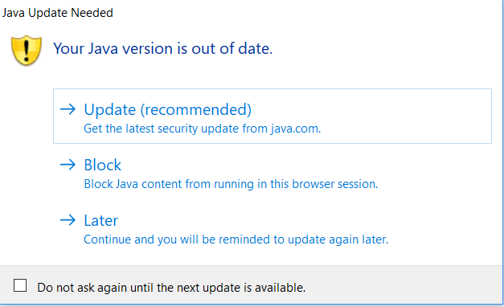

Slide 12
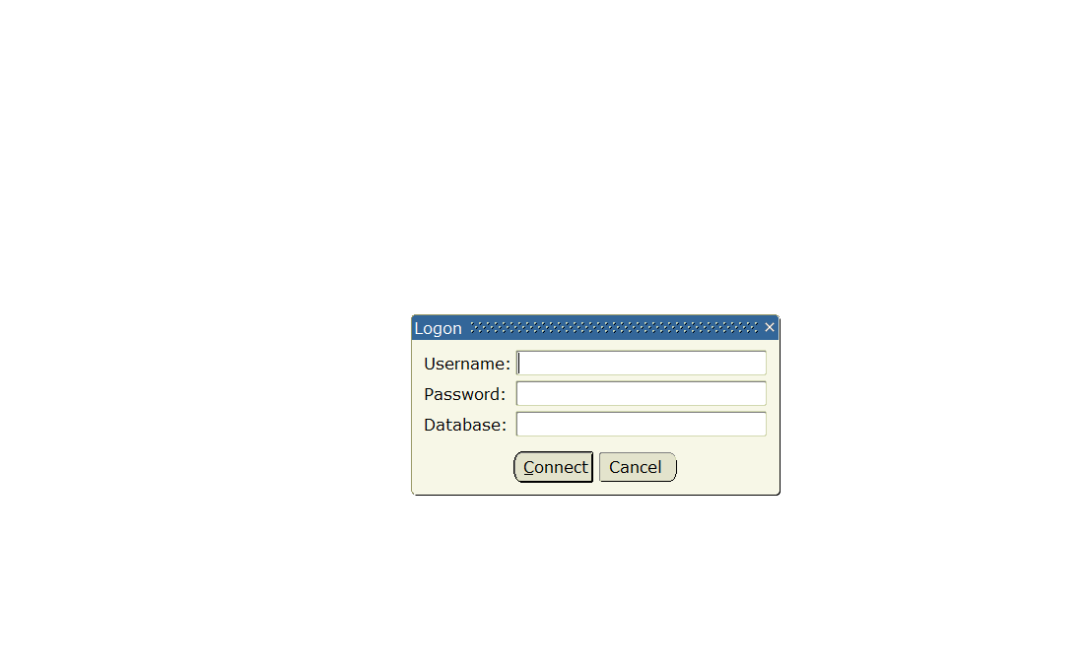

Slide 13
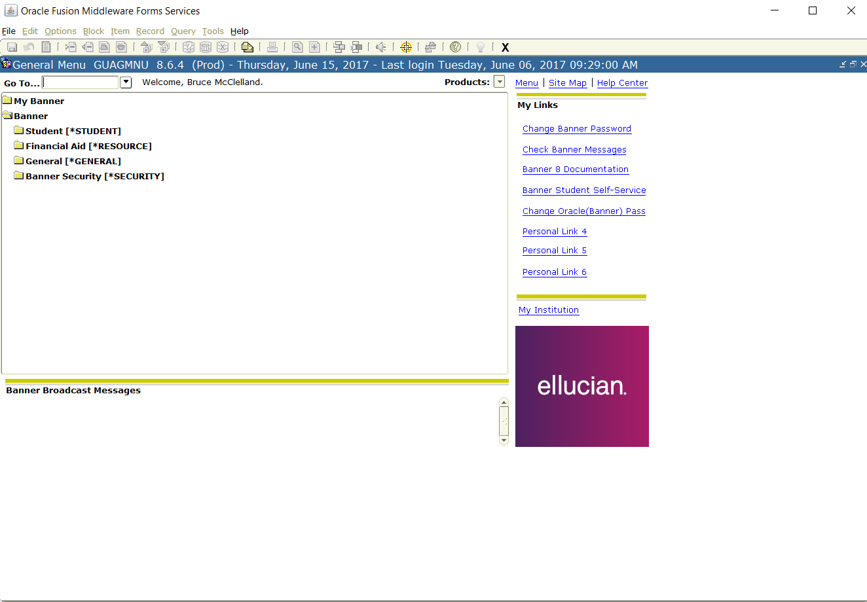

Slide 14
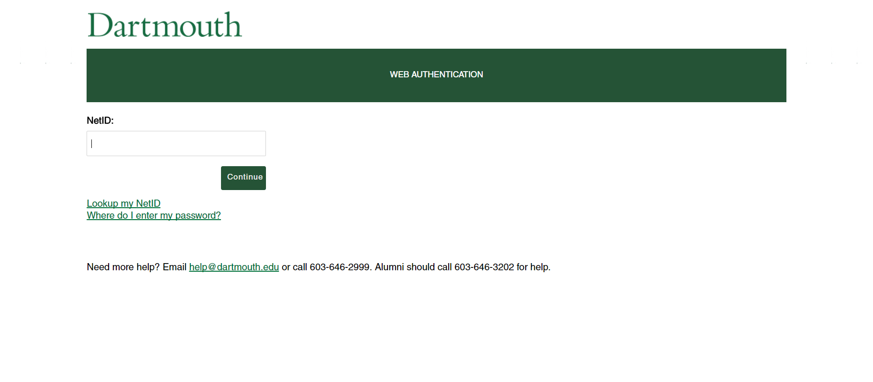

Slide 15
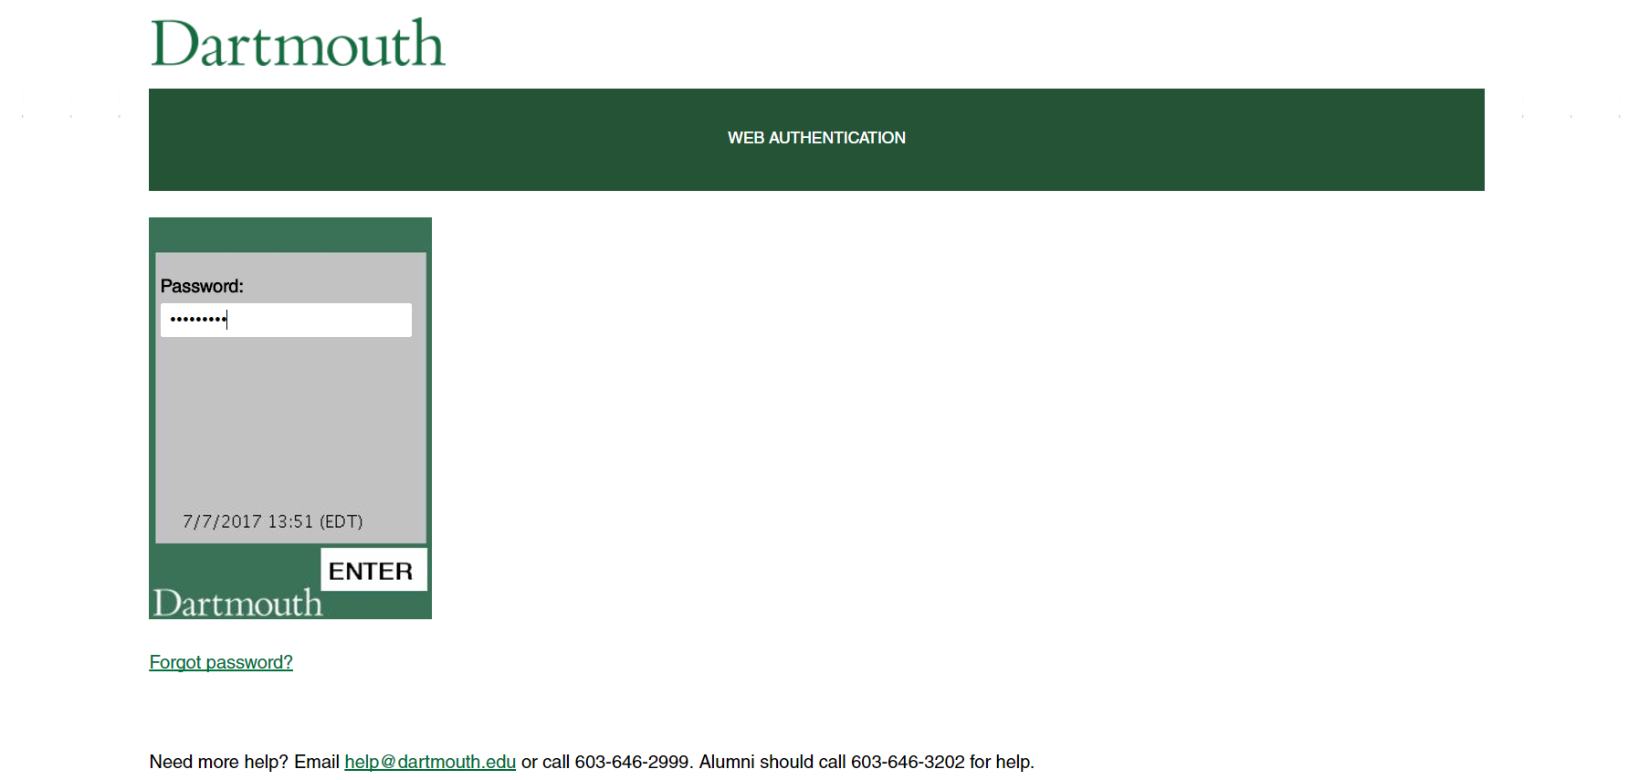

Slide 16
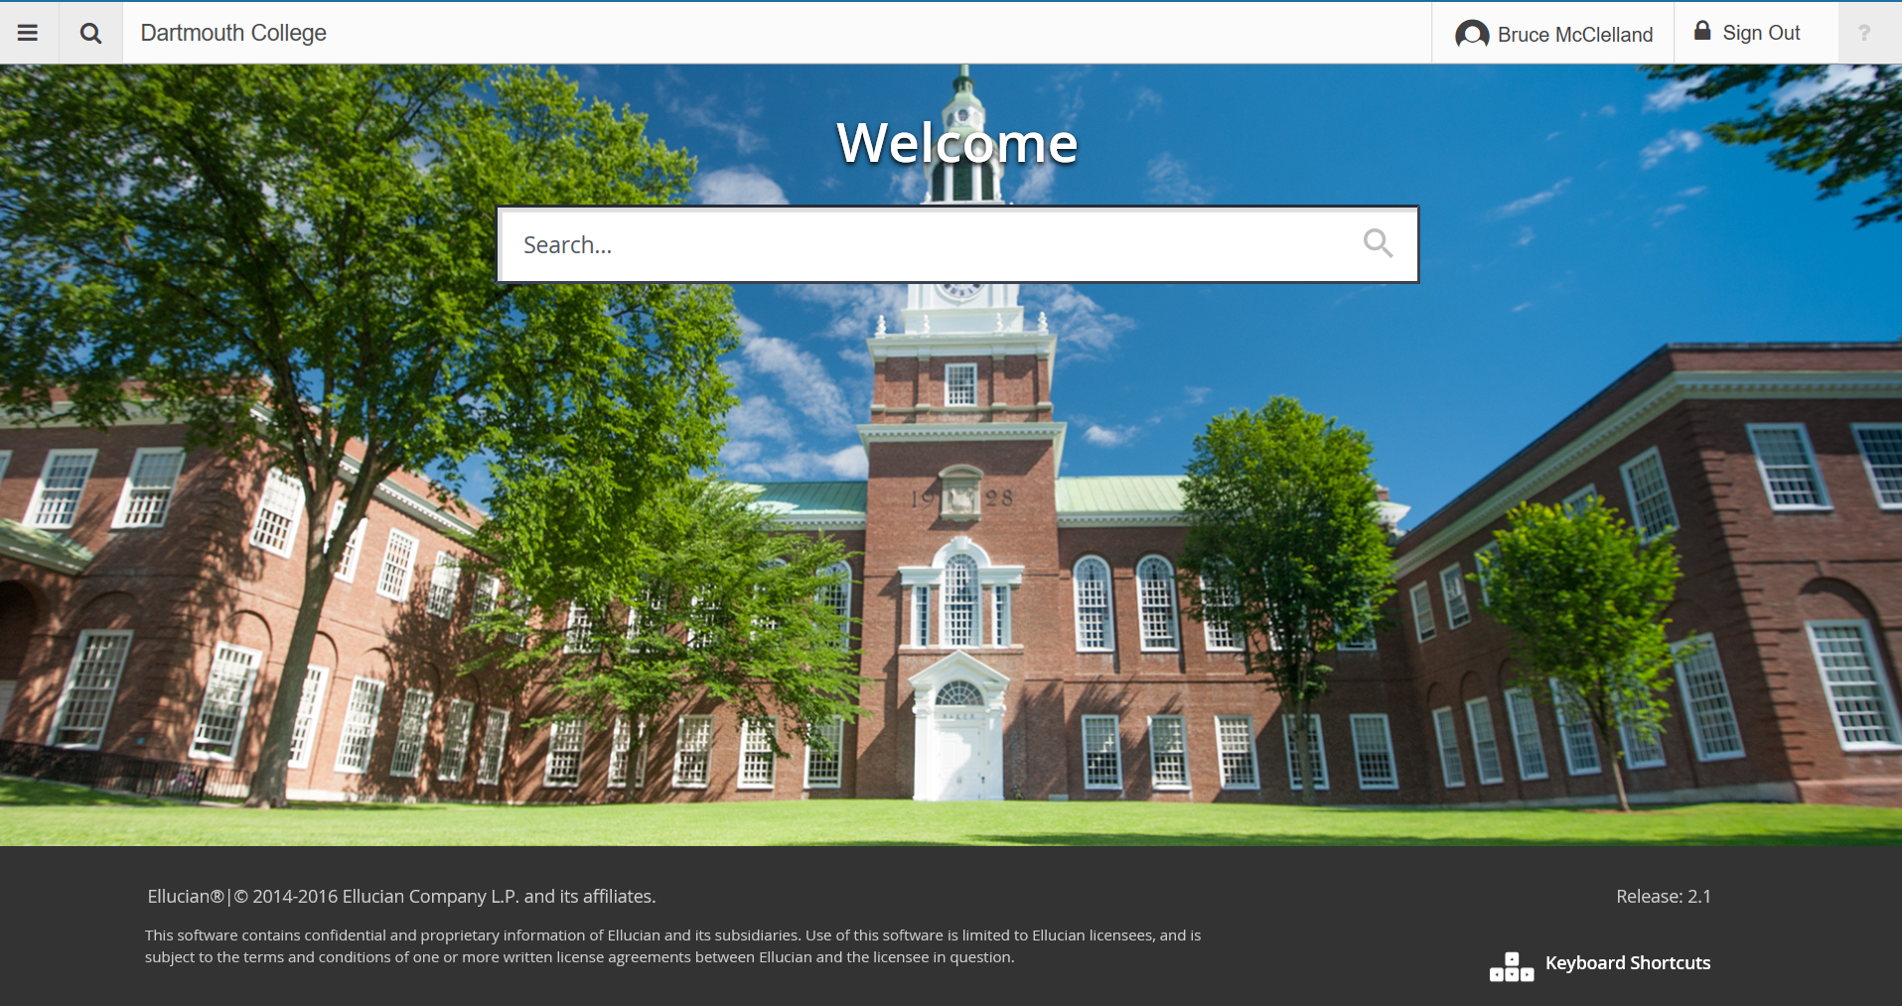

Slide 17
The Banner 9 Puzzle
Significant Upgrade
Not just User Interface change
New Architecture
Extensive changes to the ‘behind-the-scenes’ components
New features and functionality
Biggest change since the original implementation
How to fit all the new pieces together here at Dartmouth?

Slide 18
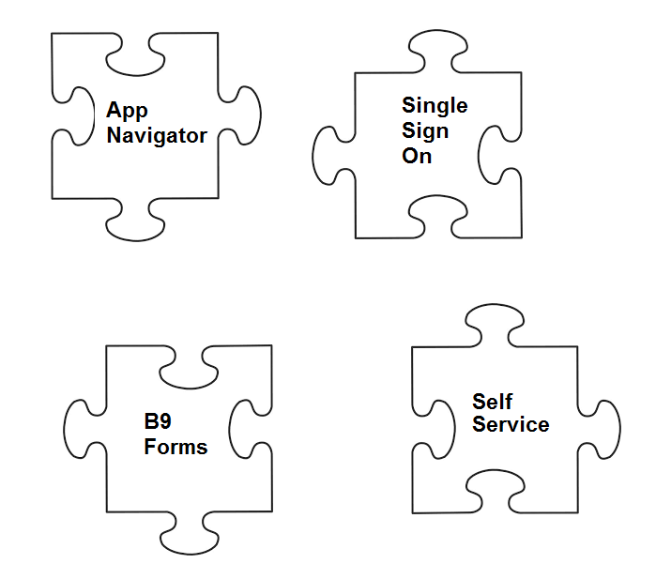

Slide 19
Collaboration and Hard Work
Student Team and Infrastructure Team worked together to understand and implement all the new technology
Area leads have met regularly to develop testing and training programs and best practices
Areas leads reviewing new Banner 9 features and functionality
Info sessions are team effort to get the word out

Slide 20
But Its Still Just an Upgrade
While this is a substantial upgrade : It is still just an upgrade
Your data is still there: Just the way you access it has been improved
Student Team, working with our key partners, already have a tried and true upgrade and testing process that we have employed for all our previous, successful upgrades
Follow the same roadmap to success

Slide 21
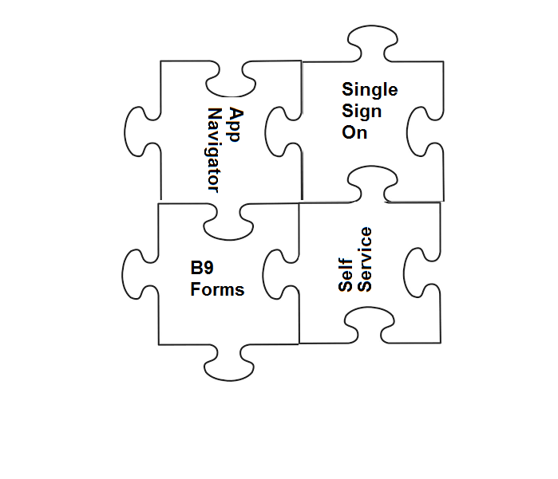

Slide 22
And now our Banner demo!

Slide 24
UG Registrar – Jose Sinclair
Geisel – Michele Jaeger
Tuck/Tuck Finance Center – Stacie Marshall
Thayer – Daryl Laware
Office of Visa Services – Marcia Calloway
Campus Billing and DartCard Services – Mark Mierswa
Campus Services – Robin Pych
UG Student Affairs – Bethanne Tillotson
UG Admissions/Fin Aid – Josh Monette
GR Registrar – Gary Hutchins
HR/Thayer Finance Center – Bruce McClelland

Slide 25
Next Steps
Visit our website with regular information updates and video training (sites.Dartmouth.edu/banner9upgrade)
Hands-on training sessions for each business area (contact team leads)
Play in the DEV environment

Slide 26
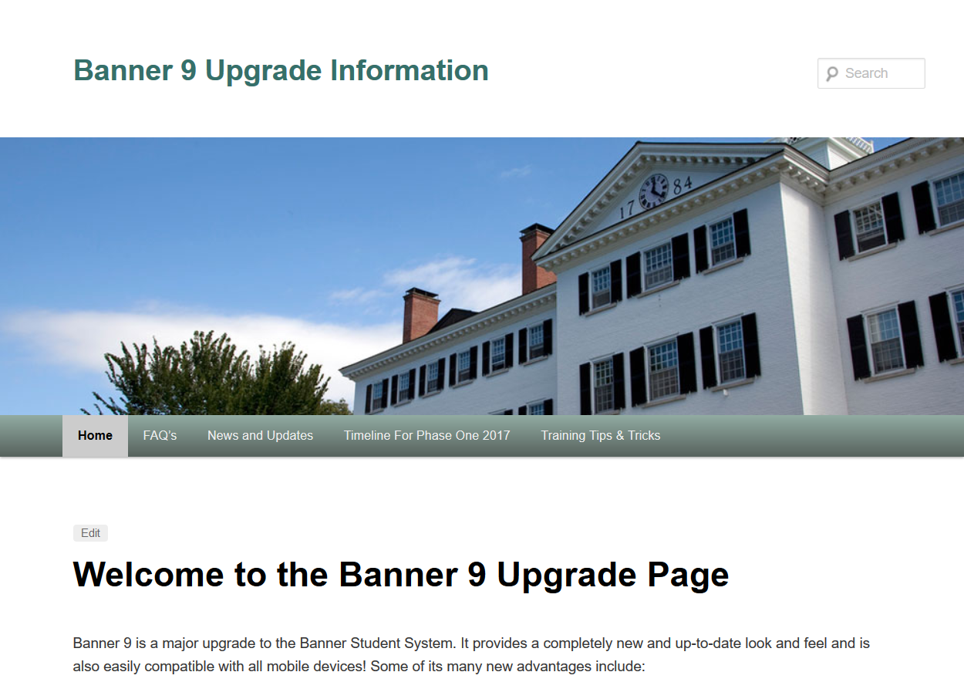

Slide 27
Thank You!

